Slide 1
Understanding Community Development
Jim Cavage, Cavage Community Development

Slide 2
Questions related to UCD
Differentiate between community and Development
What is community?
What is community development?
Differentiate between development and growth?
What is the relationship of community development and economic development?
Enumerate the principle of community development?
Key elements/ingrediants for successful community development.
What is the process of community development?
Skills/Techniques for initiating C.D projects in a community.
Discuss the action-learning cycle of Community development?

Slide 3
Community
Communities refer to location (communities of place)
or a collection of individuals with a common interest
or tie whether in close proximity or widely separated
(communities of interest)
According to Mattessich and Monsey (2004):
2. People who live within a geographically defined area
and who have social and psychological ties with each
other and with the place where they live.
3. A grouping of people who live close to one another
and are united by common interests and mutual aid.

Slide 4
Community:
A combination of social units and systems which perform the major social function… (and) the organization of social activities. (Warren 1963 cited in Mattessich and Monsey, 2004:57)

Slide 5
What is Development?
Increasing people choices
Development is a process by which the members of a society increase their personal and institutional capacities to mobilize and manage resources to produce sustainable
and justly distributed improvements in their quality of life
consistent with their own aspirations. (p. 67)

Slide 6
Principles of Community Development:
1. Community Organization:
Community Organization is the process by which people of communities as individual citizens or as representative of groups join together to determine social welfare needs, plan ways of meeting them and mobilize the necessary resources.

Slide 7
2. Acceptance and meaningful relationship
Involvement and development of trust through development of relationship and give them a sense of ownership.

Slide 8
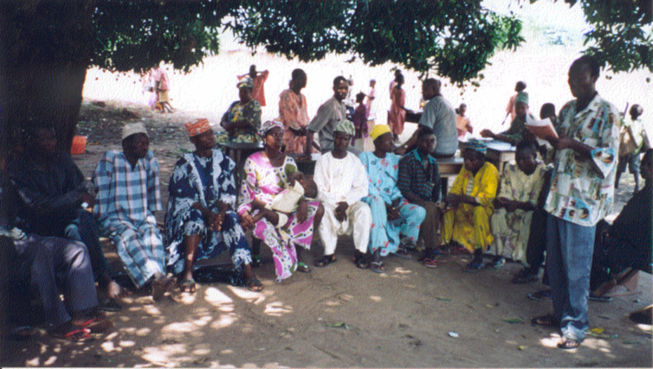
3. Principle of Discussion
The people of community should be made
to sit at some common, central and formal
place:
To discuss their problems, and
To discuss their felt needs
Whether it is:
Identification of needs
Identification of problems, and
Identification of resources

Slide 9
Or
It is creation of an organization in the community or
It is formation of community plans, and programs, or
It is the implementation of community plans and programs
Discussion is very necessary.

Slide 10
4. Principle of local Adaptation
Adaptation means to become familiar or to the process of changing to suit different conditions.
The principle of local adaptation requires that the community development must understand the local needs. It is also necessary to understand the local environments, and local situation. Similarly, it is also essential to understand the basic requirements of the people for development.

Slide 11
5. Principle of Equal Opportunity for all People
Community Development believes in democratic principle of providing equal opportunities for all sections of people, irrespective of any difference of caste, creed, color, age and sex. If one section of population of the community is ignored and left behind, balanced development of the community cannot be ensured.

